Slide 1
Lecture 08 – Image Detection and
Segmentation
Prof. André Gustavo Hochuli
gustavo.hochuli@pucpr.br
aghochuli@ppgia.pucpr.br
Notes:
Prof. André Hochuli

Slide 2
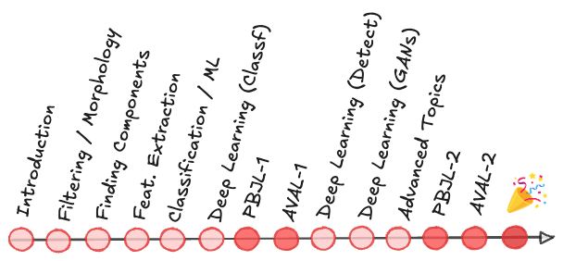
Topics
Review of Lecture 10 – CNN Applications and Tricks
Classification vs Segmentation
Classification
Object Detection
Segmentation
Practice
Computer Vision - Prof. André Hochuli
Lecture 08
Notes:
Prof. André Hochuli

Slide 3
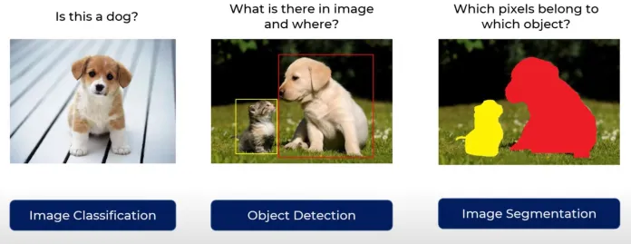
Classification vs Segmentation
Computer Vision - Prof. André Hochuli
Lecture 08
Notes:
Prof. André Hochuli

Slide 4
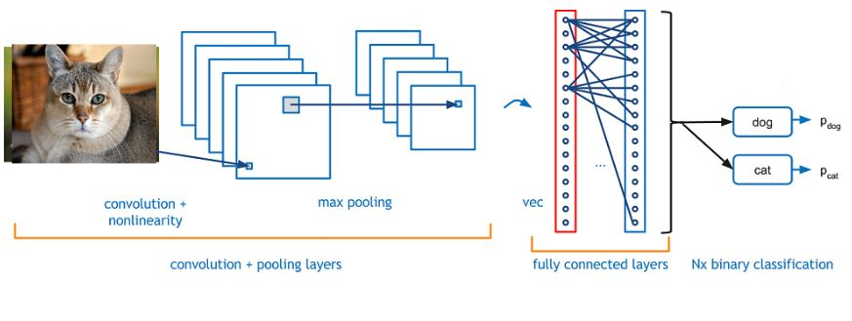
Classification
Computer Vision - Prof. André Hochuli
Lecture 08
Notes:
Prof. André Hochuli

Slide 5
Object Detection
Computer Vision - Prof. André Hochuli
Lecture 08
Notes:
Prof. André Hochuli

Slide 6
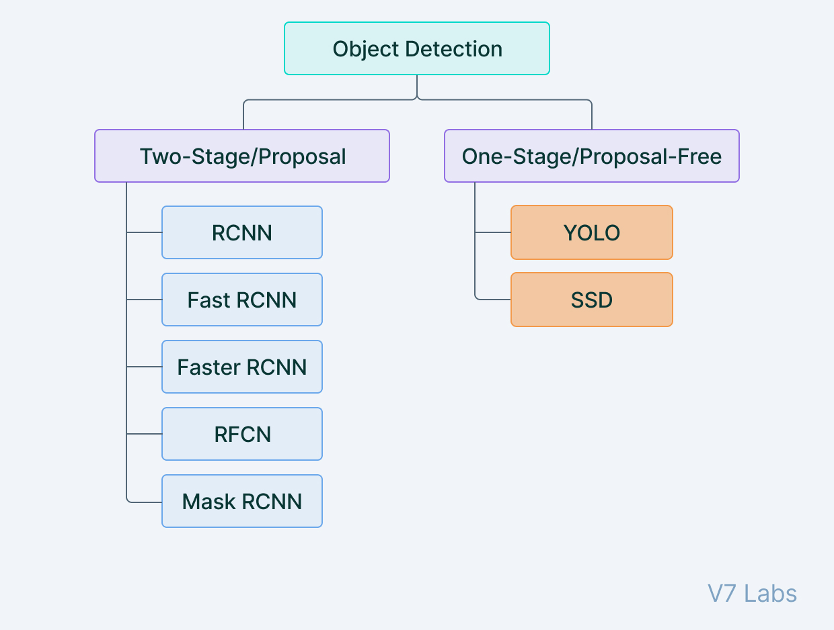
Object Detection
Computer Vision - Prof. André Hochuli
Lecture 08
Notes:
Prof. André Hochuli

Slide 7
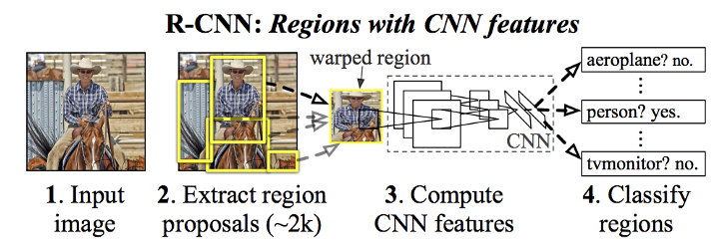
Object Detection - RCNN
Region Based Convolutional Neural Network (2014) - Ross Girshick
Selective Search Algorithm (Region Proposal)
CNN (Classification)
Computer Vision - Prof. André Hochuli
Lecture 08
Notes:
Prof. André Hochuli

Slide 8
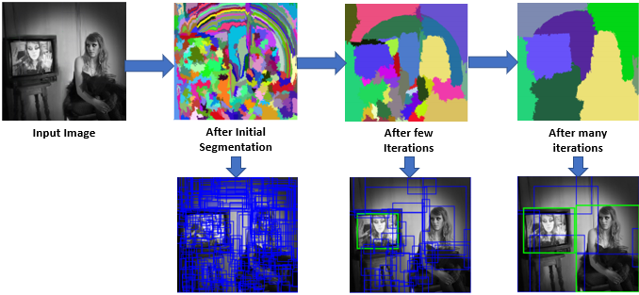
Object Detection - RCNN
Selective Search Algorithm (Region Proposal)
Computer Vision - Prof. André Hochuli
Lecture 08
Notes:
Prof. André Hochuli

Slide 9
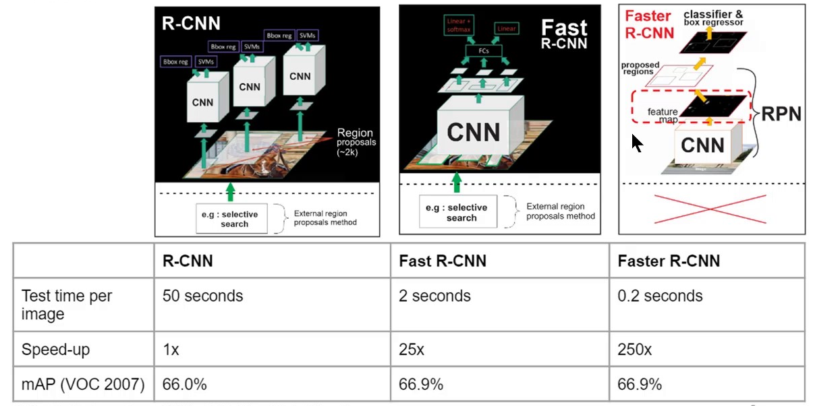
Object Detection - RCNN
R-CNN: Selective Search->CNN
Fast: End-to-end (Sel. Search->ROI Pooling→FC)
Faster: Region Proposal Network (RPN)
Computer Vision - Prof. André Hochuli
Lecture 08
Notes:
Prof. André Hochuli

Slide 10
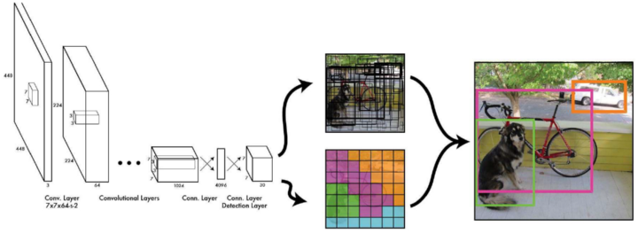
Object Detection - Yolo
You Look Once (YoLo - 2015 - now)
Joseph Redmon / Ross Girshick
Fast End-to-End Architecture
Computer Vision - Prof. André Hochuli
Lecture 08
Notes:
Prof. André Hochuli

Slide 11
Segmentation
Computer Vision - Prof. André Hochuli
Lecture 08
Notes:
Prof. André Hochuli

Slide 12
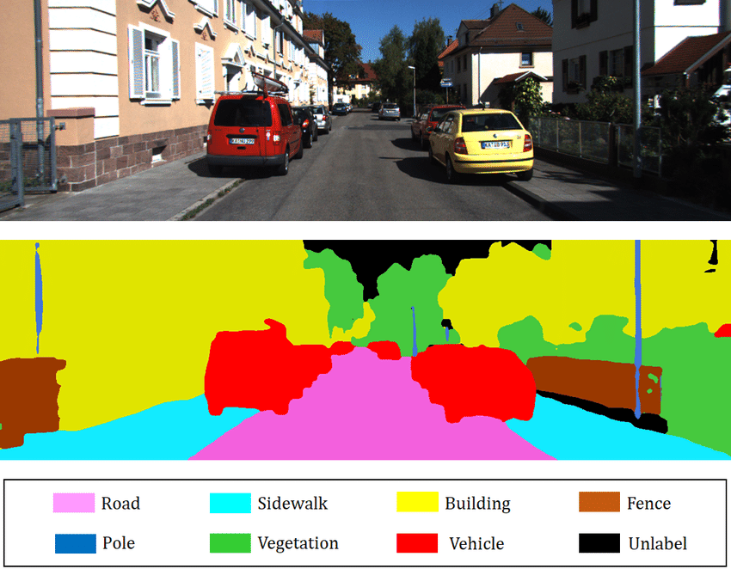
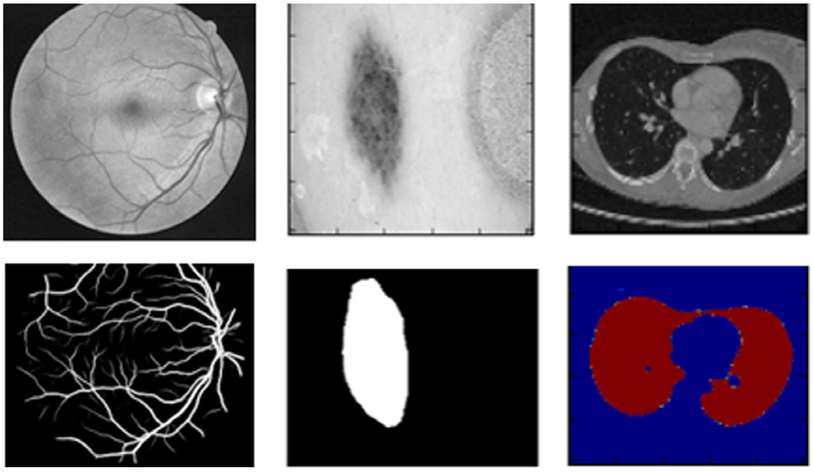
Segmentation
Classification at pixel level
Computer Vision - Prof. André Hochuli
Lecture 08
Notes:
Prof. André Hochuli

Slide 13
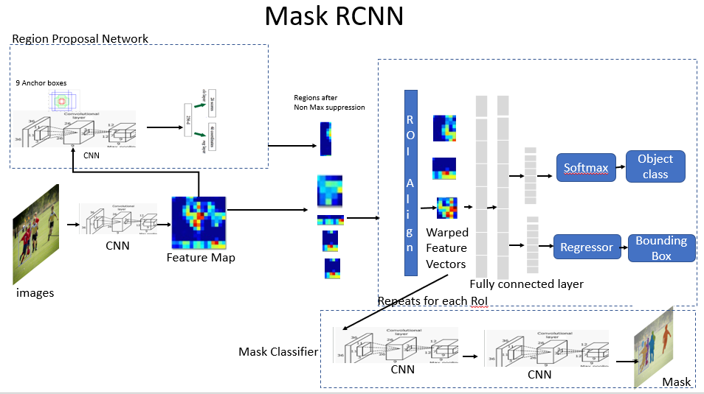
Segmentation – Mask RCNN
Faster R-CNN with Binary Mask (2017)
Computer Vision - Prof. André Hochuli
Lecture 08
Notes:
Prof. André Hochuli

Slide 14
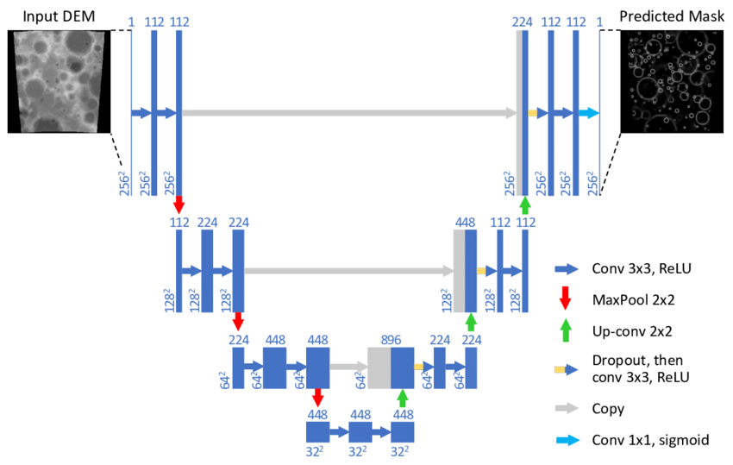
Segmentation - UNET
U-Net (Encoder and Decoder)
Encoder
Decoder
Computer Vision - Prof. André Hochuli
Lecture 08
Notes:
Prof. André Hochuli

Slide 15
YoLo – You Look Once
Notes:
Prof. André Hochuli

Slide 16
Object Detection - Yolo
You Look Once (YoLo - 2015 - now)
The input image passes through convolutional backbone (e.g., Darknet)
The output is a feature map of lower spatial resolution (e.g for instance, 80×80, 20x20 )
The split is applied on the latent (feature map), not the raw input. Each feature cell corresponds to a specific spatial region (receptive field) of the input image.
Computer Vision - Prof. André Hochuli
Lecture 08
Notes:
Prof. André Hochuli

Slide 17
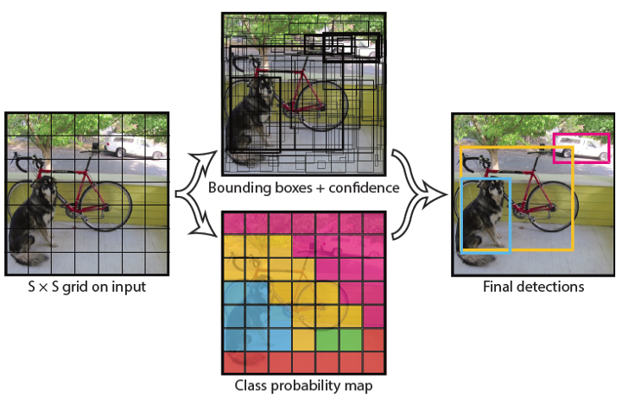
Object Detection - Yolo
Regression is the key!
Bounding boxes are treated as continuous variablesin normalized image coordinates.
(x,y,w,h)=(0.25,0.40,0.20,0.10)
Computer Vision - Prof. André Hochuli
Lecture 08
Notes:
Prof. André Hochuli

Slide 18
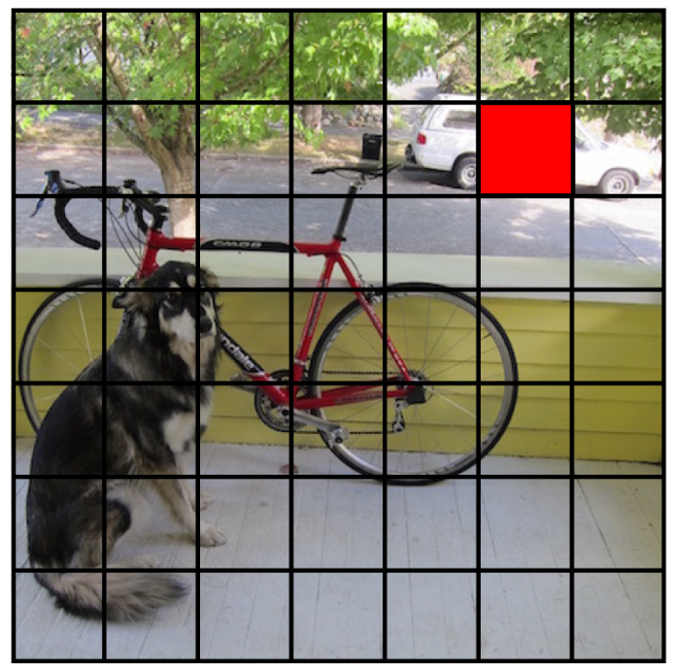
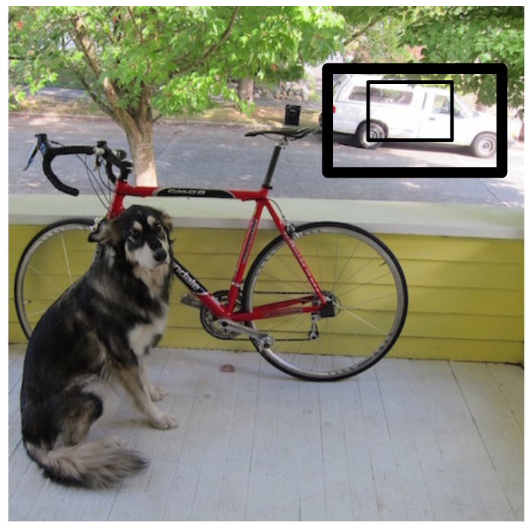
Object Detection - Yolo
Each cell predicts bounding boxes and confidences
P(object): [0,1] quantifies the confidence that any object occupies this box (not background)
Computer Vision - Prof. André Hochuli
Lecture 08
Notes:
Prof. André Hochuli

Slide 19
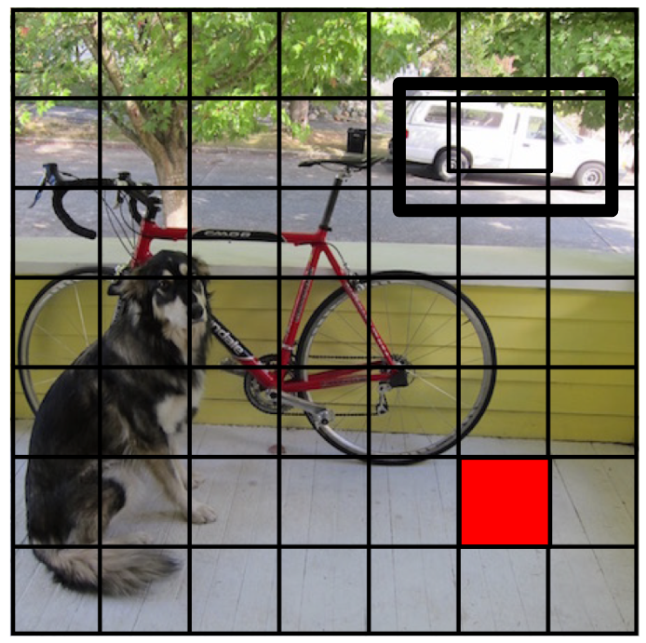
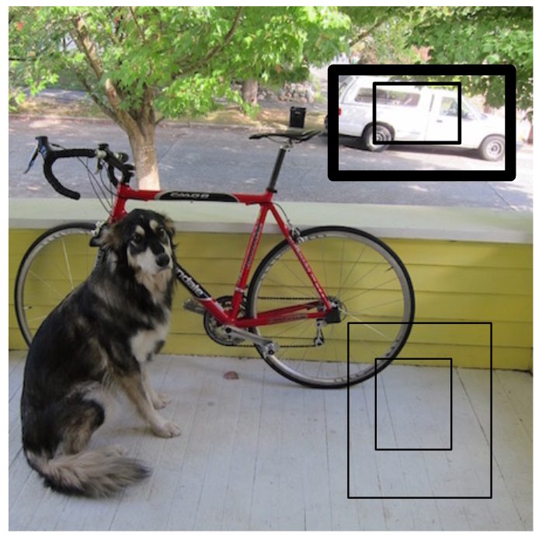
Object Detection - Yolo
Each cell predicts bounding boxes and confidences
P(object): [0,1] quantifies the confidence that any object occupies this box (not background)
Computer Vision - Prof. André Hochuli
Lecture 08
Notes:
Prof. André Hochuli

Slide 20
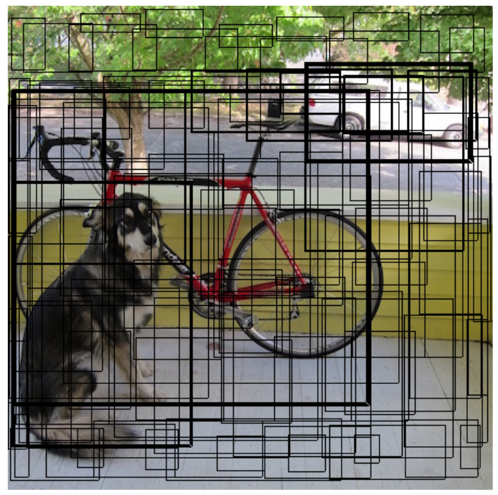
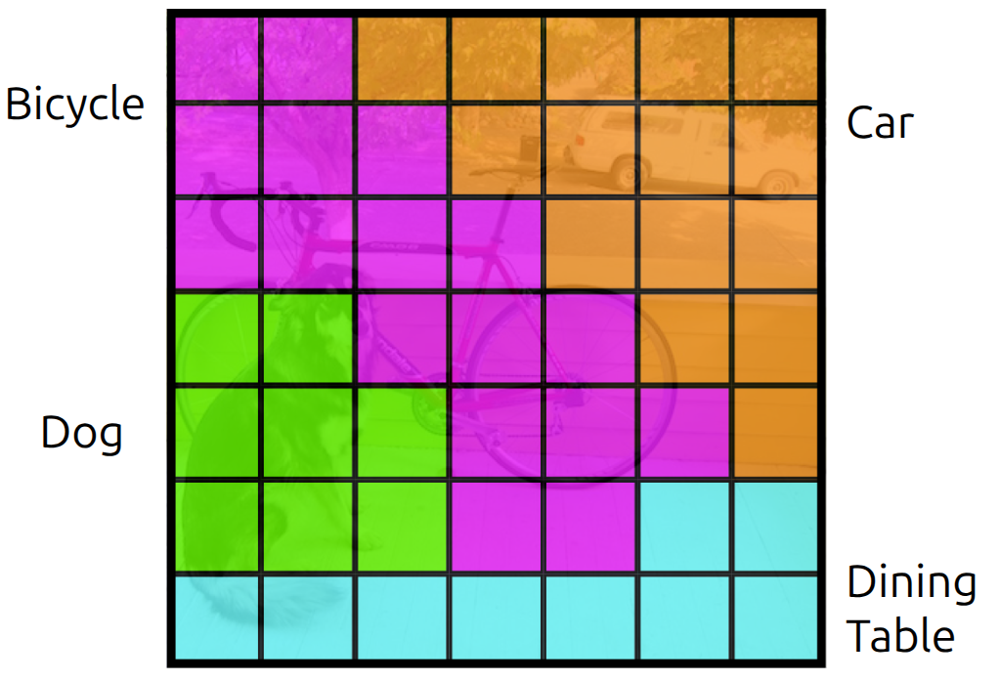
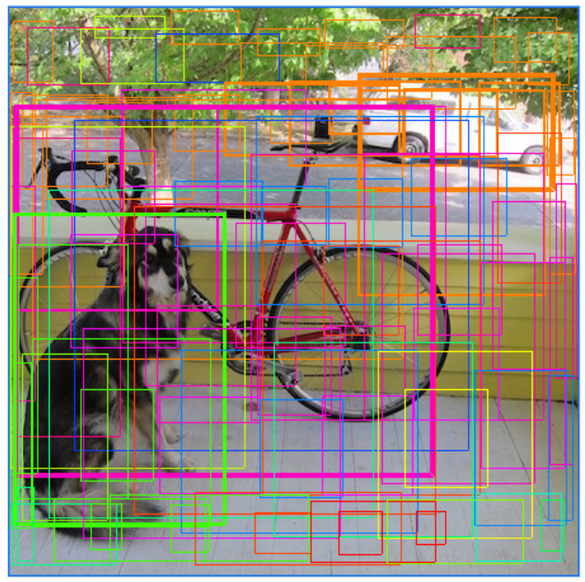
Object Detection - Yolo
Class Prob = P(class) => P(car) = 0.8
Conditionated Prob: e.g P(class | object) => P(car) = 0.9
Confidence:
P(Object) * P (Car | Object) = 0.72
Computer Vision - Prof. André Hochuli
Lecture 08
Notes:
Prof. André Hochuli

Slide 21
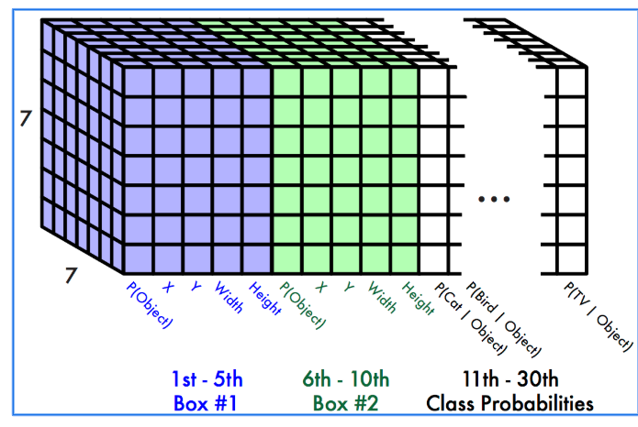
Object Detection - Yolo
Each cell predicts:
Bounding Boxes:
4 Coordinates (X,Y,W,H)
1 Confidence
I.E PASCAL VOC
7x7 Grid
2 Bounding Box / Cell
20 Classes
7 * 7 * (2 * 5 + 20) = 7x7*30 tensors per cell => 1470 predictions per image
Computer Vision - Prof. André Hochuli
Lecture 08
Notes:
Prof. André Hochuli

Slide 22
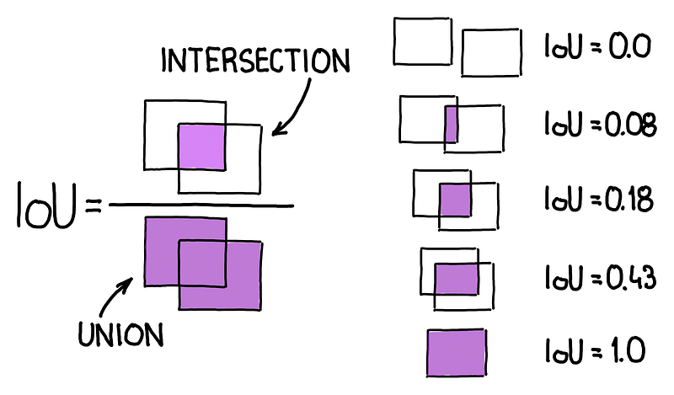
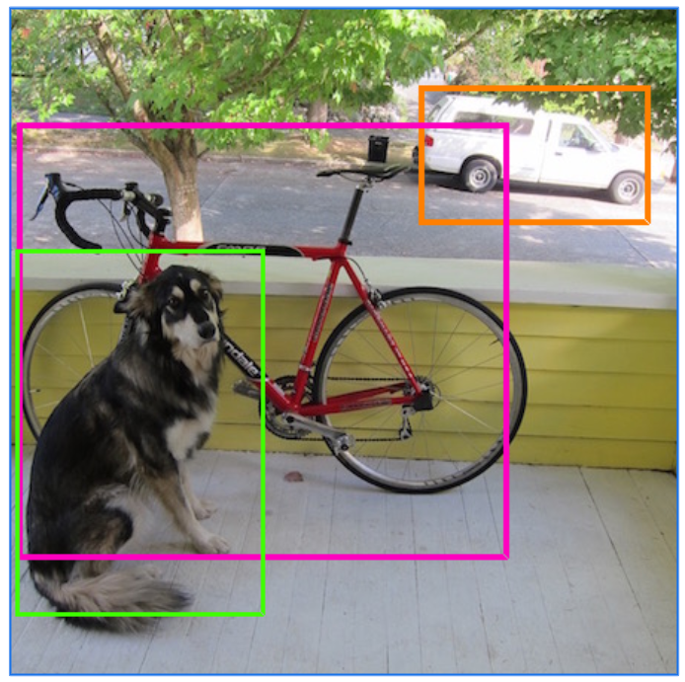
Object Detection - Yolo
Non-Maximum Supression (NMS)
Sort all boxes by confidence score (P(object)×P(class).
Pick the box with the highest score → keep it as the best detection.
Compute IoU between this box and all others
Remove all boxes with IoU above the suppression threshold (e.g., 0.5)
Repeat until all boxes are processed
NMS
Computer Vision - Prof. André Hochuli
Lecture 08
Notes:
Prof. André Hochuli

Slide 23
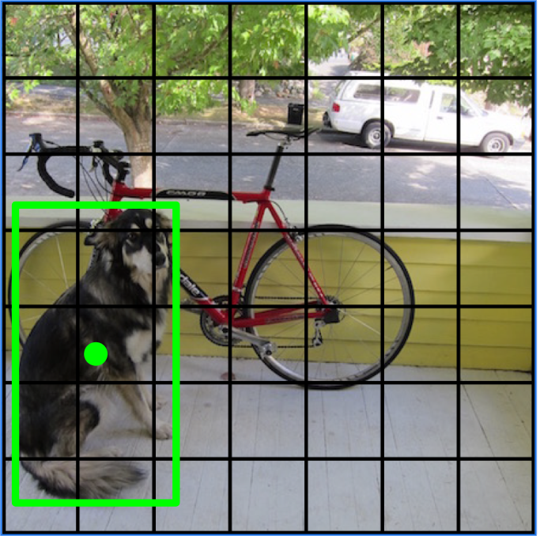
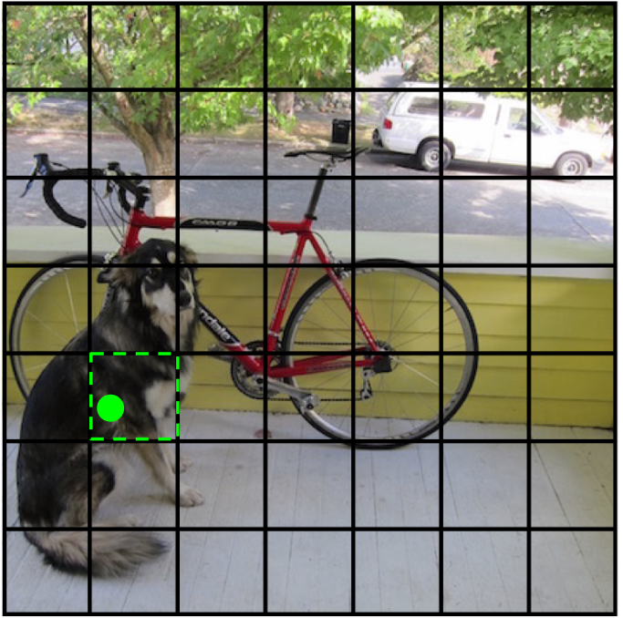
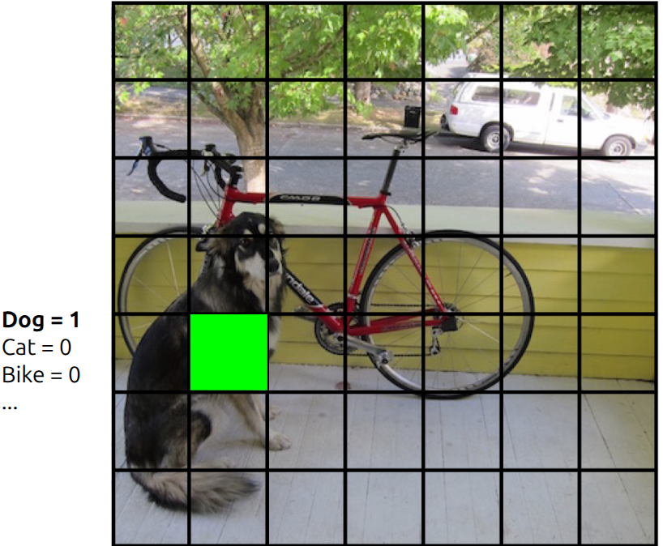
Object Detection - Yolo
Training
Match example to the right cell (ground-truth)
Computer Vision - Prof. André Hochuli
Lecture 08
Notes:
Prof. André Hochuli

Slide 24
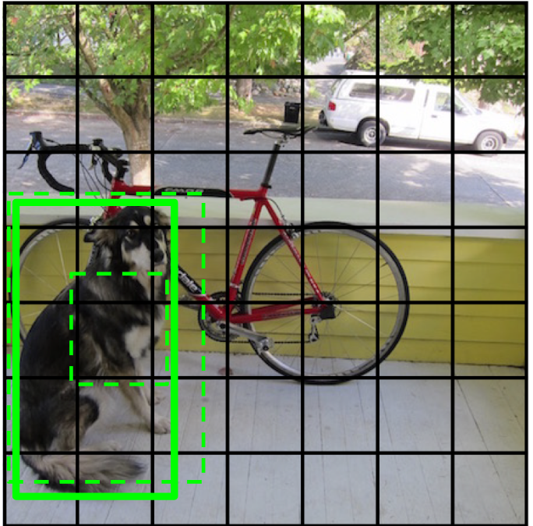
Object Detection - Yolo
Training
Predict Bounding-Boxes
Selects the best fit and increases its confidence
Penalizes all other predictions
Computer Vision - Prof. André Hochuli
Lecture 08
Notes:
Prof. André Hochuli

Slide 25
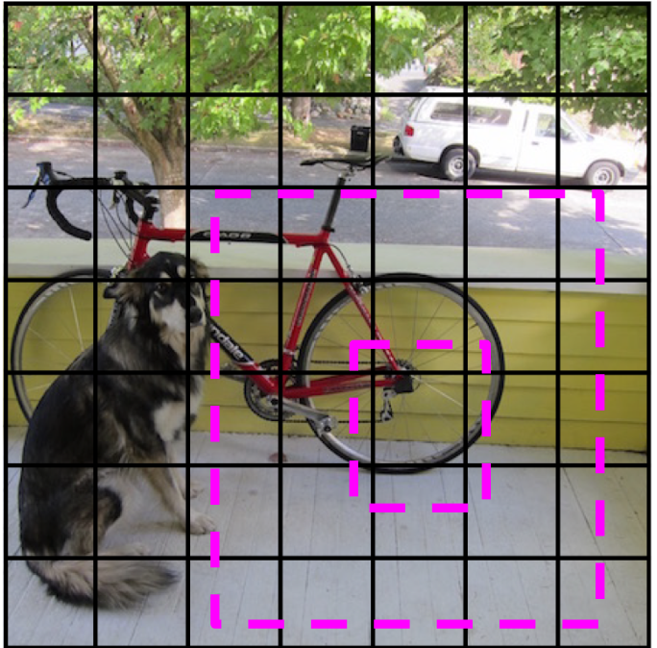
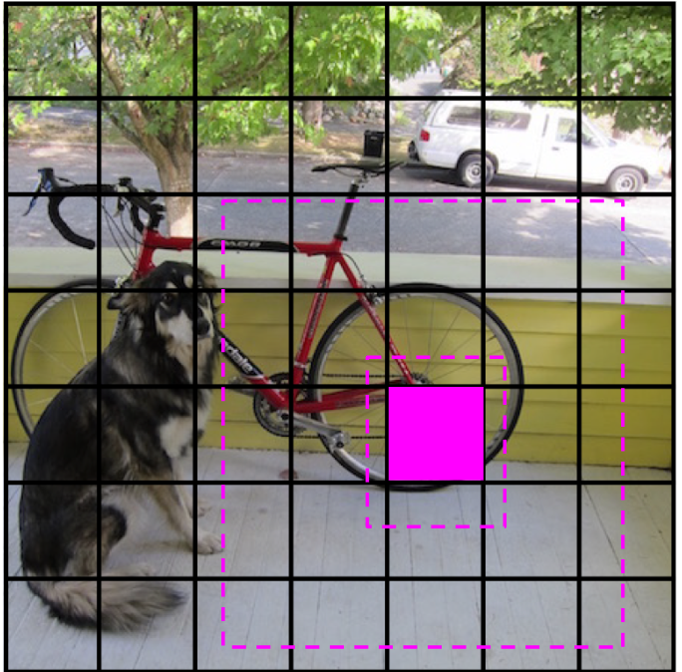
Object Detection - Yolo
Training
Penalizes when the prediction does not match any class (i.e., background).
Computer Vision - Prof. André Hochuli
Lecture 08
Notes:
Prof. André Hochuli

Slide 26
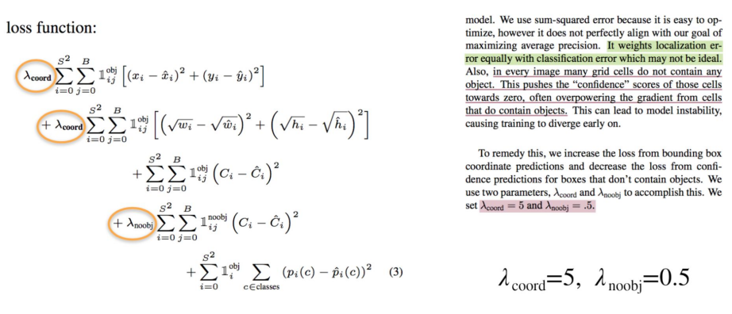
Object Detection - Yolo
Computer Vision - Prof. André Hochuli
Lecture 08
Notes:
Prof. André Hochuli

Slide 27
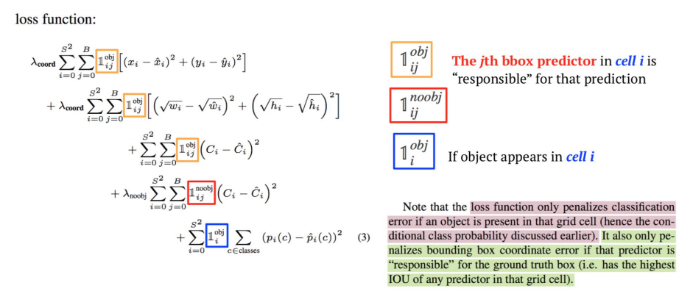
Object Detection - Yolo
Computer Vision - Prof. André Hochuli
Lecture 08
Notes:
Prof. André Hochuli

Slide 28
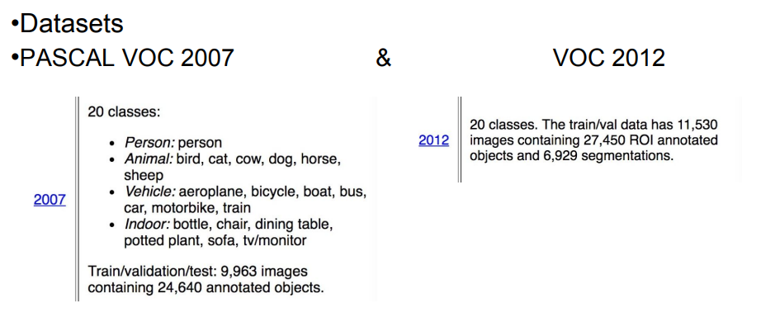
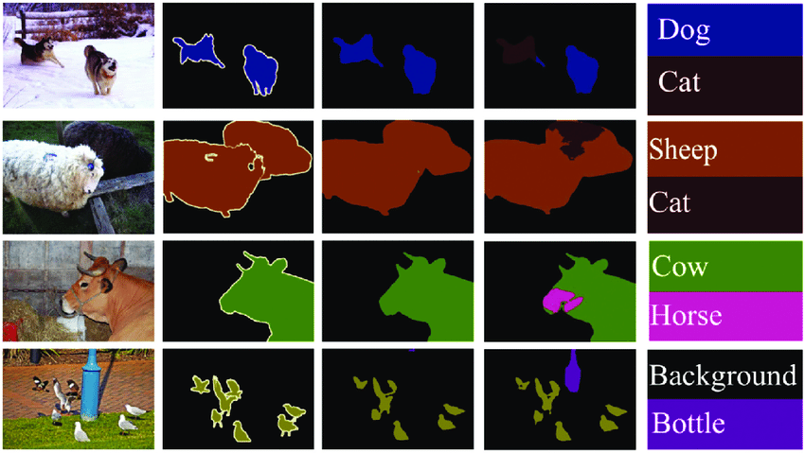
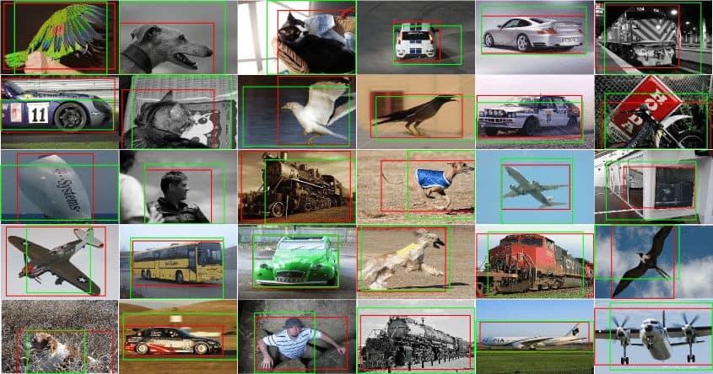
Object Detection - Yolo
Computer Vision - Prof. André Hochuli
Lecture 08
Notes:
Prof. André Hochuli

Slide 29
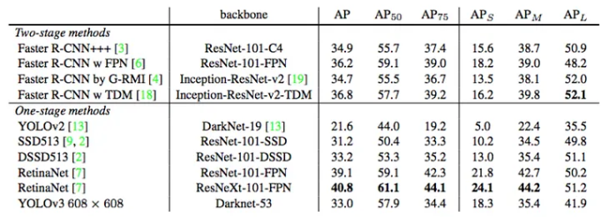
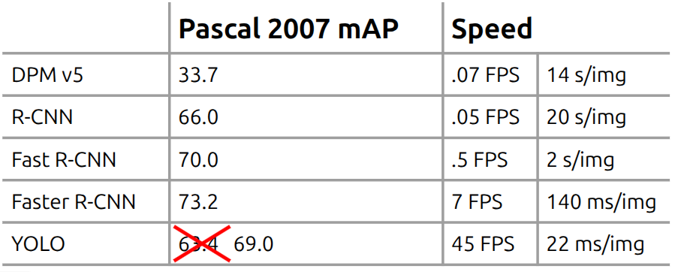
Object Detection - Yolo
Computer Vision - Prof. André Hochuli
Lecture 08
Notes:
Prof. André Hochuli

Slide 30
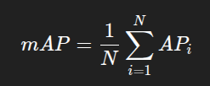
Object Detection - Yolo
mAP measures a detector’s average precision across all classes.
Computer Vision - Prof. André Hochuli
Lecture 08
Notes:
Prof. André Hochuli

Slide 31
Object Detection - Yolo
Let’s Code!
This exercise will utilize Ultralytics (www.ultralytics.com) as the framework.
Single Image
Frame by Frame (Video / Camera)
Check out the GitHub repository, specifically the yolo-ultralytics folder.
Computer Vision - Prof. André Hochuli
Lecture 08
Notes:
Prof. André Hochuli

Slide 32
YoLo – Training and Annotation
Notes:
Prof. André Hochuli

Slide 33
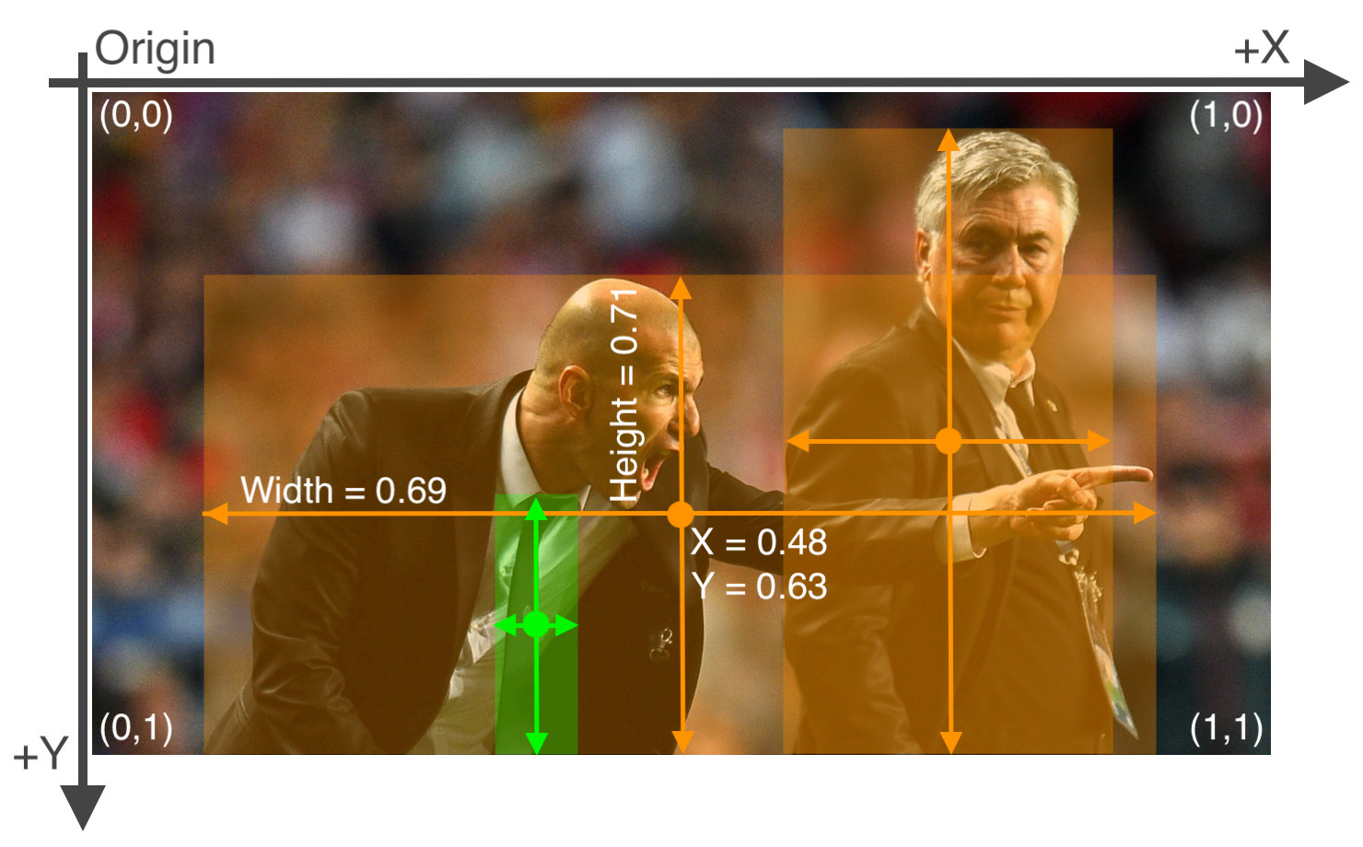
Yolo Training
Each image must include:
Bounding box coordinates (4 points) and the corresponding class label
Bounding boxes should be relative (normalized), not absolute pixel coordinates
Avaliable annotation tools:
LabelImg (simple and lightweight)
LabelMe (browser-based)
CVAT (advanced, collaborative)
Roboflow Annotate
Computer Vision - Prof. André Hochuli
Lecture 08
Notes:
Prof. André Hochuli

Slide 34
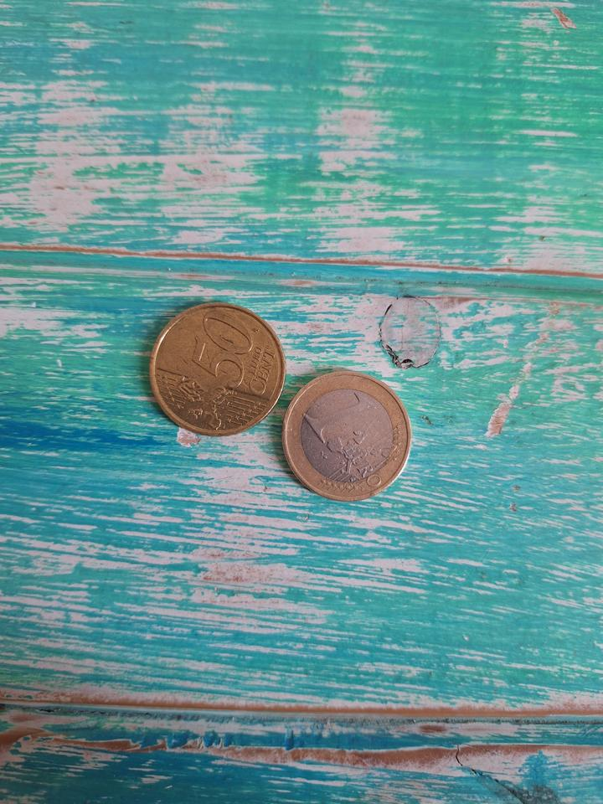
Yolo Training
5 0.360417 0.459375 0.229167 0.165625
6 0.575000 0.543750 0.216667 0.162500
Computer Vision - Prof. André Hochuli
Lecture 08
Notes:
Prof. André Hochuli

Slide 35
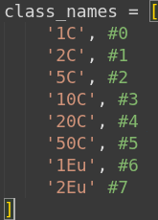
Yolo Training
5
5 0.360417 0.459375 0.229167 0.165625
6 0.575000 0.543750 0.216667 0.162500
6
Computer Vision - Prof. André Hochuli
Lecture 08
Notes:
Prof. André Hochuli

Slide 36
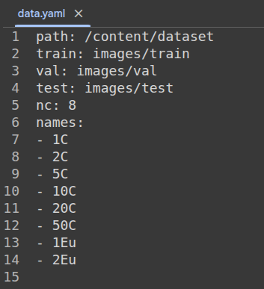
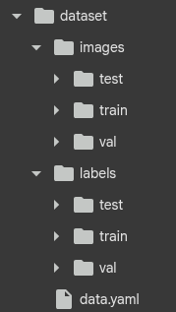
Yolo Training
5
6
Let’s Code!
Computer Vision - Prof. André Hochuli
Lecture 08
Notes:
Prof. André Hochuli

Slide 37
U-Net
Notes:
Prof. André Hochuli

Slide 38
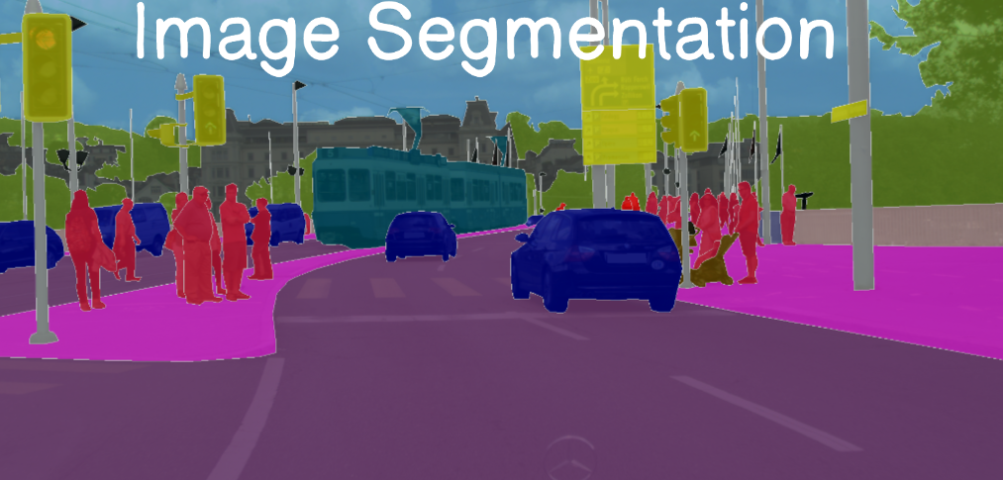
Segmentation Task
Process of assigning a label to each pixel in an image to partition it into meaningful regions.
Precise object localization and delineation
Precise object localization and delineation
State-of-The-Art Architectures
FCN (Fully Conv. Networks)(*)
U-NET(*)
DeepLab
Mask R-CNN
Computer Vision - Prof. André Hochuli
Lecture 08
Notes:
Prof. André Hochuli

Slide 39
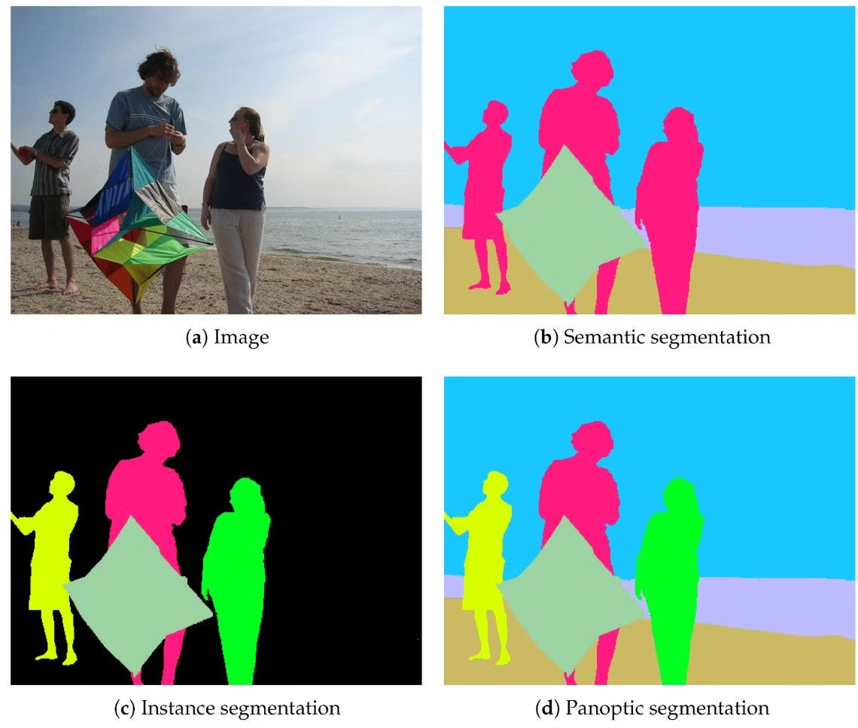
Segmentation Task
Types of Segmentation
Semantic Segmentation: Classify each pixel into predefined classes (e.g., road, car, sky)
Instance Segmentation: Detect and delineate each object instance separately
Panoptic Segmentation: Combines semantic and instance segmentation in a unified view
Computer Vision - Prof. André Hochuli
Lecture 08
Notes:
Prof. André Hochuli

Slide 40
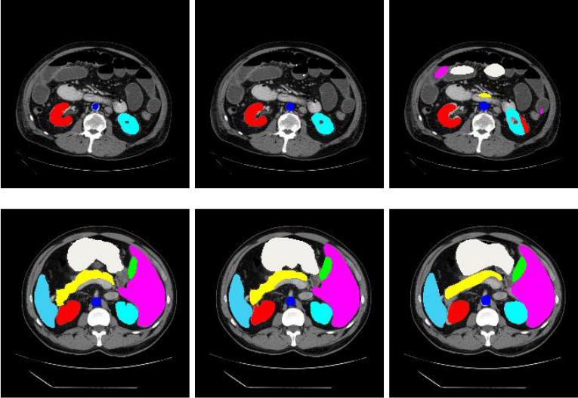
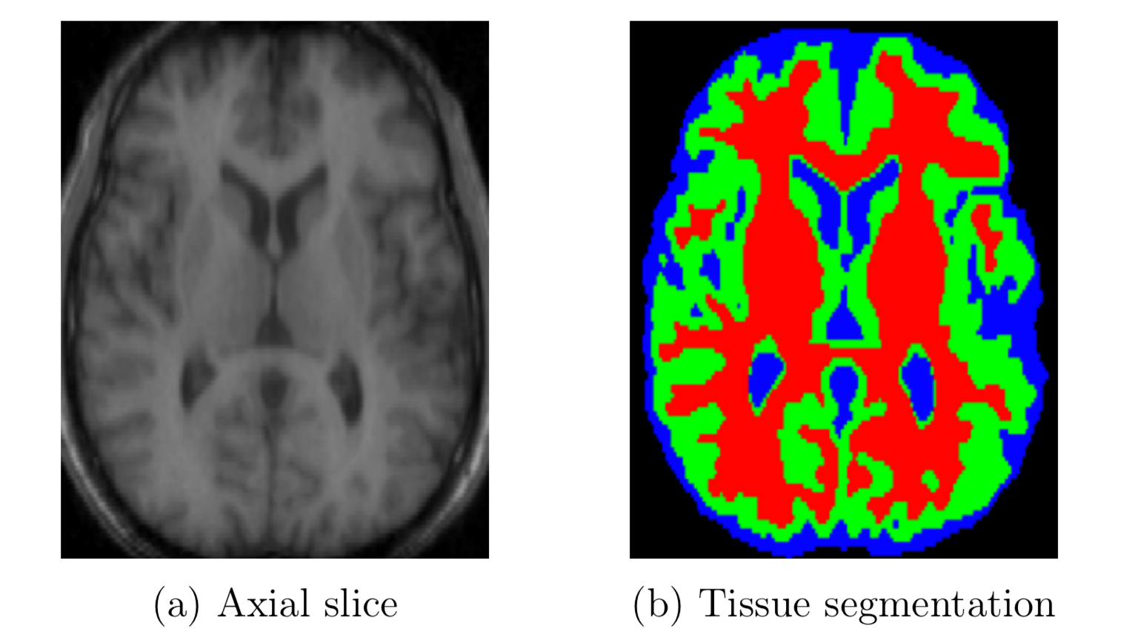
Segmentation Task
Applications:
Medical imaging: Tumor or organ segmentation
Computer Vision - Prof. André Hochuli
Lecture 08
Notes:
Prof. André Hochuli

Slide 41
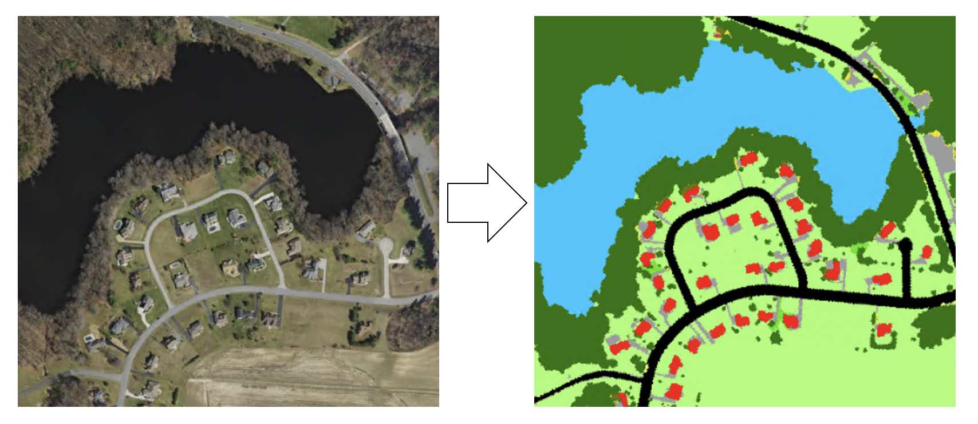
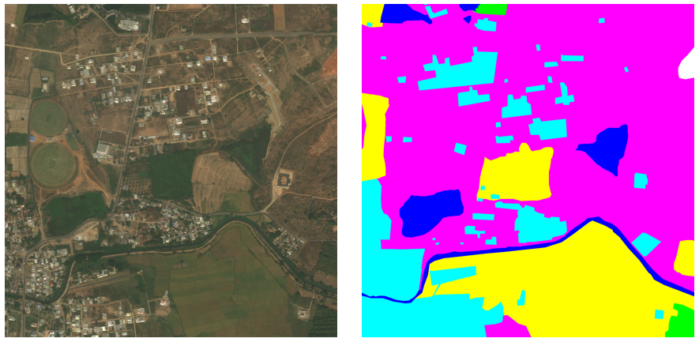
Segmentation Task
Applications:
Remote sensing: Land cover mapping
Computer Vision - Prof. André Hochuli
Lecture 08
Notes:
Prof. André Hochuli

Slide 42
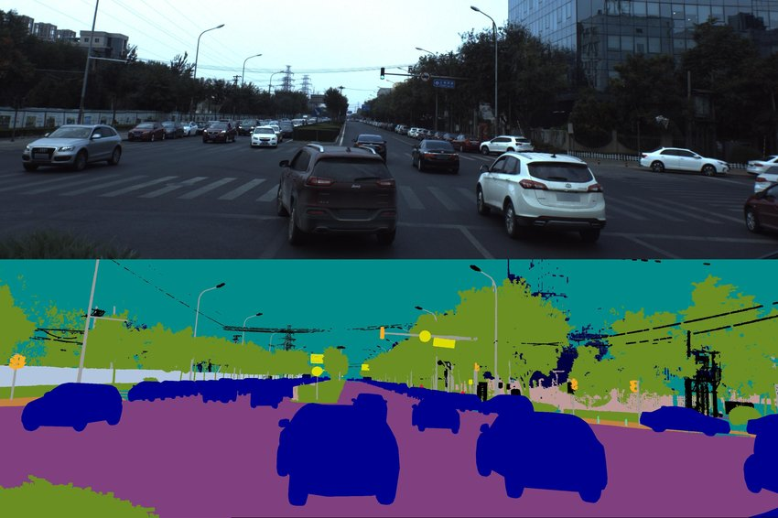
Segmentation Task
Applications:
Autonomous vehicles: Road scene understanding.
Computer Vision - Prof. André Hochuli
Lecture 08
Notes:
Prof. André Hochuli

Slide 43
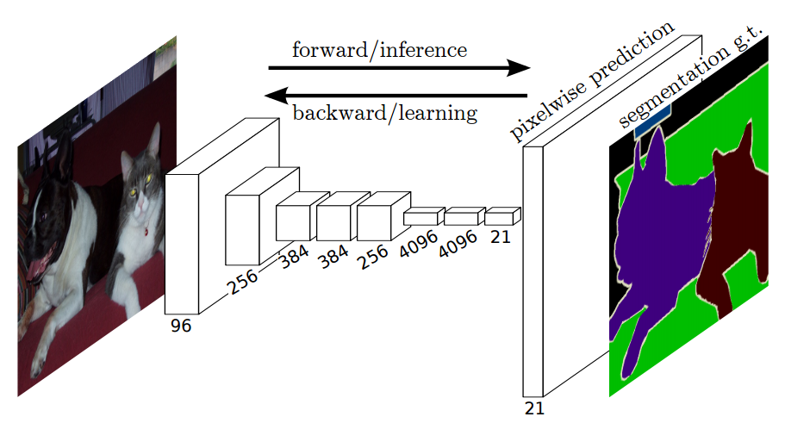

Fully Convolutional Network (FCN)
Replace fully connected layers in CNNs with convolutional layers to produce dense pixel-level predictions
Encoder derived from classical classification networks (e.g., VGG, AlexNet)]
Decoder built using upsampling (deconvolution) layers to recover spatial resolution
Skip connections from shallow layers to refine details
Computer Vision - Prof. André Hochuli
Lecture 08
Notes:
Prof. André Hochuli

Slide 44
UNET
U-Net (Encoder and Decoder)
Symmetric encoder–decoder with dense skip links
Encoder (contracting path) captures context through convolution + pooling
Decoder (expanding path) upsamples using transposed convolutions.
Encoder
Decoder
Bottleneck
Computer Vision - Prof. André Hochuli
Lecture 08
Notes:
Prof. André Hochuli

Slide 45


Learnable Upsampling
Simple Upsampling: Fixed Interpolation
Learnable Upsampling: Transpose convolution learns the inverse mapping of a convolution to produce larger feature maps.
Computer Vision - Prof. André Hochuli
Lecture 08
Notes:
Prof. André Hochuli

Slide 46

UNET
Training UNET
Paired: Input → Mask (Segmentation)
Significant Annotation Cost
Computer Vision - Prof. André Hochuli
Lecture 08
Notes:
Prof. André Hochuli

Slide 47

UNET
Training UNET
Losses
Binary Cross-Entropy (BCE)
Minimize pixel-level differences
Treats each pixel independently, penalizing wrong foreground/background classification.
Sensitive to class imbalance (e.g., small objects vs. large background)
Computer Vision - Prof. André Hochuli
Lecture 08
Notes:
Prof. André Hochuli

Slide 48

UNET
Training UNET
Losses
Dice Score
Maximize the overlap between predicted and ground truth masks.
Emphasizes correct segmentation of regions, not individual pixels.
Robust when foreground regions are small (Class Imbalance)
Computer Vision - Prof. André Hochuli
Lecture 08
Notes:
Prof. André Hochuli

Slide 49
UNET
Let’s Code!!
Computer Vision - Prof. André Hochuli
Lecture 08
Notes:
Prof. André Hochuli

